Slide 1

Elementary Statistics
Thirteenth Edition
Chapter 8
Hypothesis Testing
Copyright © 2018, 2014, 2012 Pearson Education, Inc. All Rights Reserved

Slide 2
Hypothesis Testing
8-1 Basics of Hypothesis Testing
8-2 Testing a Claim about a Proportion
8-3 Testing a Claim About a Mean
8-4 Testing a Claim About a Standard Deviation or Variance

Slide 3
Key Concept (1 of 2)
This section describes a complete procedure for testing a claim made about a population proportion p. We illustrate hypothesis testing with the P-value method, the critical value method, and the use of confidence intervals. The methods of this section can be used with claims about population proportions, probabilities, or the decimal equivalents of percentages.

Slide 4
Key Concept (2 of 2)
There are different methods for testing a claim about a population proportion. Part 1 of this section is based on the use of a normal approximation to a binomial distribution, and this method serves well as an introduction to basic concepts, but it is not a method used by professional statisticians. Part 2 discusses other methods that might require the use of technology.

Slide 5
Testing a Claim About a Population Proportion (Normal Approximation Method): Objective
Objective
Conduct a formal hypothesis test of a claim about a population proportion p.

Slide 6
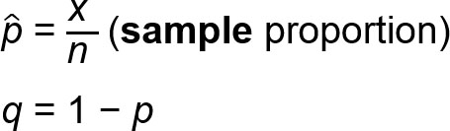
Testing a Claim About a Population Proportion (Normal Approximation Method): Notation
Notation
n = sample size or number of trials
p = population proportion (p is the value used in the statement of the null hypothesis)

Slide 7
Testing a Claim About a Population Proportion (Normal Approximation Method): Requirements (1 of 2)
Requirements
The sample observations are a simple random sample.
The conditions for a binomial distribution are satisfied:
There is a fixed number of trials.
The trials are independent.
Each trial has two categories of “success” and “failure.”
The probability of a success remains the same in all trials.

Slide 8
Testing a Claim About a Population Proportion (Normal Approximation Method): Requirements (2 of 2)
Requirements
The conditions np ≥ 5 and nq ≥ 5 are both satisfied, so the binomial distribution of sample proportions can be approximated by a normal distribution with

Slide 9
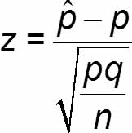
Testing a Claim About a Population Proportion (Normal Approximation Method): Test Statistic for Testing a Claim about a Proportion (1 of 2)

Slide 10
Testing a Claim About a Population Proportion (Normal Approximation Method): Test Statistic for Testing a Claim about a Proportion (2 of 2)
P-values: P-values are automatically provided by technology. If technology is not available, use the standard normal distribution (Table A-2) and refer to Figure 8-3 on page 364.
Critical values: Use the standard normal distribution (Table A-2).

Slide 11
Equivalent Methods
When testing claims about proportions, the confidence interval method is not equivalent to the P-value and critical value methods, so the confidence interval method could result in a different conclusion. (Both the P-value method and the critical value method use the same standard deviation based on the claimed proportion p, so they are equivalent to each other, but the confidence interval method uses an estimated standard deviation based on the sample proportion.)
Recommendation: Use a confidence interval to estimate a population proportion, but use the P-value method or critical value method for testing a claim about a proportion.

Slide 12
Example: Claim − Most Consumers Uncomfortable with Drone Deliveries (1 of 16)
1009 consumers were asked if they are comfortable with having drones deliver their purchases, and 54% (or 545) of them responded with “no.” Use these results to test the claim that most consumers are uncomfortable with drone deliveries. We interpret “most” to mean “more than half” or “greater than 0.5.”

Slide 13
Example: Claim − Most Consumers Uncomfortable with Drone Deliveries (2 of 16)
Requirement Check
We first check the three requirements.
The 1009 consumers are randomly selected.
There is a fixed number (1009) of independent trials with two categories (the subject is uncomfortable with drone deliveries or is not).

Slide 14
Example: Claim − Most Consumers Uncomfortable with Drone Deliveries (3 of 16)
Requirement Check
The requirements np ≥ 5 and nq ≥ 5 are both satisfied with n = 1009, p = 0.5, and q = 0.5. [The value of p = 0.5 comes from the claim. We get np = (1009)(0.5) = 504.5, which is greater than or equal to 5, and we get nq = (1009)(0.5) = 504.5, which is also greater than or equal to 5.]
The three requirements are satisfied.

Slide 15
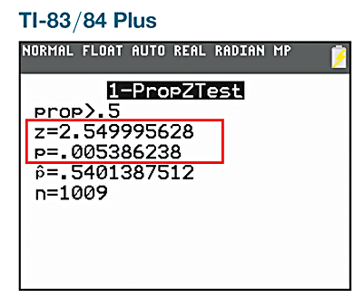
Example: Claim − Most Consumers Uncomfortable with Drone Deliveries (4 of 16)
Solution: P-Value Method
Technology: Computer programs and calculators usually provide a P-value, so the P-value method is used. See the accompanying TI-83/84 Plus calculator results showing the alternative hypothesis of “prop > 0.5,” the test statistic of z = 2.55 (rounded), and the P-value of 0.0054 (rounded).

Slide 16
Example: Claim − Most Consumers Uncomfortable with Drone Deliveries (5 of 16)
Solution: P-Value Method
Table A-2: If technology is not available, Figure 8-1 on page 360 lists the steps for using the P-value method. Using those steps from Figure 8-1, we can test the claim as follows.
Step 1: The original claim is that most consumers are uncomfortable with drone deliveries, and that claim can be expressed in symbolic form as p > 0.5.
Step 2: The opposite of the original claim is p ≤ 0.5.

Slide 17
Example: Claim − Most Consumers Uncomfortable with Drone Deliveries (6 of 16)
Solution: P-Value Method
Step 3: Of the preceding two symbolic expressions, the expression p > 0.5 does not contain equality, so it becomes the alternative hypothesis. The null hypothesis is the statement that p equals the fixed value of 0.5. We can therefore express H₀ and H₁ as follows:
H₀: p = 0.5
H₁: p > 0.5 (original claim)

Slide 18
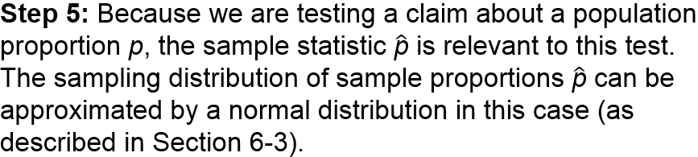
Example: Claim − Most Consumers Uncomfortable with Drone Deliveries (7 of 16)
Solution: P-Value Method
Step 4: For the significance level, we select α = 0.05, which is a very common choice.

Slide 19
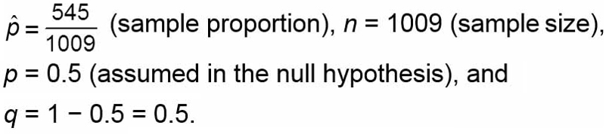
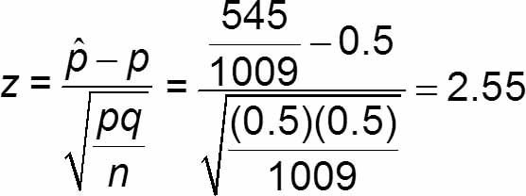
Example: Claim − Most Consumers Uncomfortable with Drone Deliveries (8 of 16)
Solution: P-Value Method
Step 6: The test statistic z = 2.55 can be found by using technology or it can be calculated by using

Slide 20
Example: Claim − Most Consumers Uncomfortable with Drone Deliveries (9 of 16)
Solution: P-Value Method
Because this hypothesis test is right-tailed with a test statistic of z = 2.55. The P-value is the area to the right of z = 2.55. Referring to Table A-2, the cumulative area to the left of z = 2.55 is 0.9946, so the area to the right of that test statistic is 1 − 0.9946 = 0.0054. We get P-value = 0.0054.

Slide 21
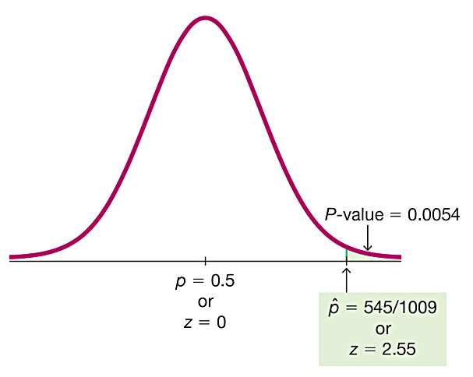
Example: Claim − Most Consumers Uncomfortable with Drone Deliveries (10 of 16)
Solution: P-Value Method

Slide 22
Example: Claim − Most Consumers Uncomfortable with Drone Deliveries (11 of 16)
Solution: P-Value Method
Step 7: Because the P-value of 0.0054 is less than or equal to the significance level of α = 0.05, we reject the null hypothesis.
Step 8: Because we reject H₀: p = 0.5, we support the alternative hypothesis of p > 0.5. We conclude that there is sufficient sample evidence to support the claim that more than half of consumers are uncomfortable with drone deliveries.

Slide 23
Example: Claim − Most Consumers Uncomfortable with Drone Deliveries (12 of 16)
Solution: Critical Value Method (steps 1 to 5 are the same as the previous method)
Step 6: The test statistic is computed to be z = 2.55. With the critical value method, we now find the critical values. This is a right-tailed test, so the area of the critical region is an area of α = 0.05 in the right tail. Referring to Table A-2 and applying the methods of Section 6-1, we find that the critical value is z = 1.645, which is at the boundary of the critical region.

Slide 24
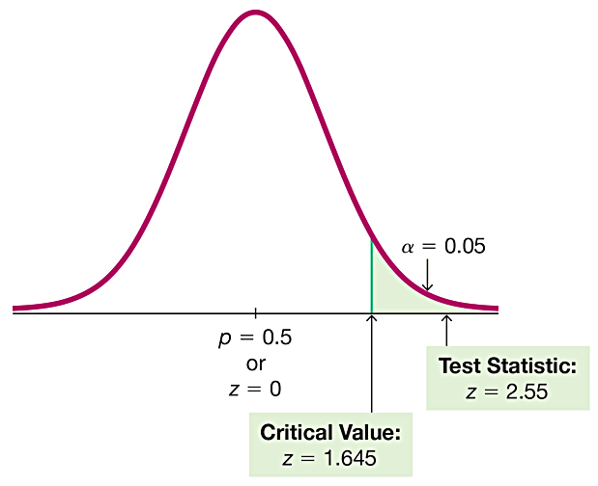
Example: Claim − Most Consumers Uncomfortable with Drone Deliveries (13 of 16)
Solution: Critical Value Method

Slide 25
Example: Claim − Most Consumers Uncomfortable with Drone Deliveries (14 of 16)
Solution: Critical Value Method
Step 7: Because the test statistic does fall within the critical region, we reject the null hypothesis.
Step 8: Because we reject H₀: p = 0.5, we conclude that there is sufficient sample evidence to support the claim that most (more than half) consumers are uncomfortable with drone deliveries.

Slide 26
Example: Claim − Most Consumers Uncomfortable with Drone Deliveries (15 of 16)
Solution: Confidence Interval Method
The claim “The Majority of Consumers Are Not Comfortable with Drone Deliveries,” can be tested with a 0.05 significance level by constructing a 90% confidence interval.

Slide 27
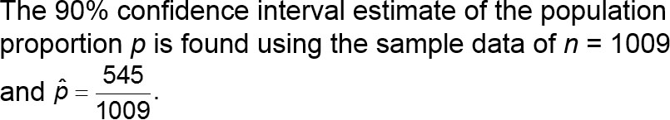
Example: Claim − Most Consumers Uncomfortable with Drone Deliveries (16 of 16)
Solution: Confidence Interval Method
Using the methods of Section 7-1 we get: 0.514 < p < 0.566. The entire range of values in this confidence interval is greater than 0.5. We are 90% confident that the limits of 0.514 and 0.566 contain the true value of p, the sample data appear to support the claim that most (more than 0.5) consumers are uncomfortable with drone deliveries.

Slide 28
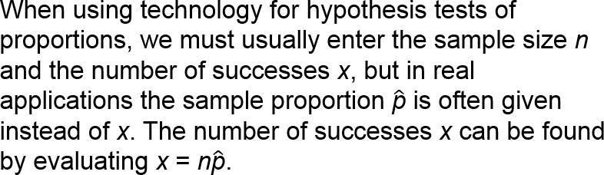
Finding the Number of Successes x
Note that in the next example, the result of 5587.712 adults must be rounded to the nearest whole number of 5588.

Slide 29
Example: Finding the number of Successes x (1 of 2)
A study of sleepwalking or “nocturnal wandering” was described in Neurology magazine, and it included information that 29.2% of 19,136 American adults have sleepwalked. What is the actual number of adults who have sleepwalked?

Slide 30
Example: Finding the number of Successes x (2 of 2)
Solution
The number of adults who have sleepwalked is 29.2% of 19,136, or 0.292×19,136 = 5587.712, but the result must be a whole number, so we round the product to the nearest whole number of 5588.

Slide 31
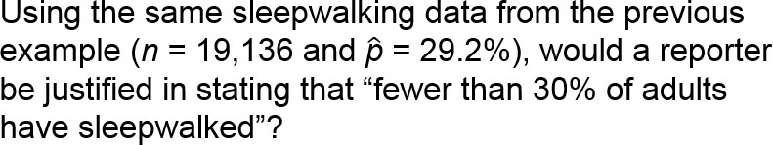
Example: Fewer Than 30% of Adults have Sleepwalked? (1 of 8)
Let’s use a 0.05 significance level to test the claim that for the adult population, the proportion of those who have sleepwalked is less than 0.30.

Slide 32
Example: Fewer Than 30% of Adults have Sleepwalked? (2 of 8)
Solution
Requirement Check
(1) The sample is a simple random sample.
(2) There is a fixed number (19,136) of independent trials with two categories (a subject has sleepwalked or has not).
(3) The requirements np ≥ 5 and nq ≥ 5 are both satisfied with n = 19,136 and p = 0.30. [We get np = (19,136)(0.30) = 5740.8, which is greater than or equal to 5, and we also get nq = (19,136)(0.70) = 13,395.2, which is greater than or equal to 5.]
The three requirements are all satisfied.

Slide 33
Example: Fewer Than 30% of Adults have Sleepwalked? (3 of 8)
Solution
Step 1: The original claim is expressed in symbolic form as p < 0.30.
Step 2: The opposite of the original claim is p ≥ 0.30.
Step 3: Because p < 0.30 does not contain equality, it becomes H₁. We get
H₀: p = 0.30 (null hypothesis)
H₁: p < 0.30 (alternative hypothesis and original claim)

Slide 34
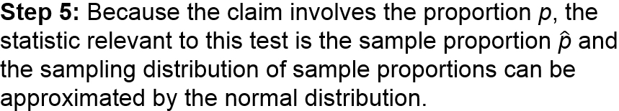
Example: Fewer Than 30% of Adults have Sleepwalked? (4 of 8)
Solution
Step 4: The significance level is α = 0.05.

Slide 35
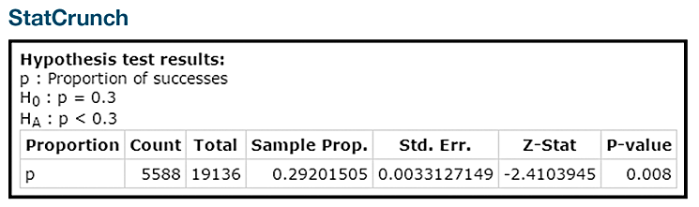
Example: Fewer Than 30% of Adults have Sleepwalked? (5 of 8)
Solution
Step 6: Technology If using technology, the test statistic and the P-value will be provided. See the accompanying results from StatCrunch showing that the test statistic is z = −2.41 (rounded) and the P-value = 0.008.

Slide 36
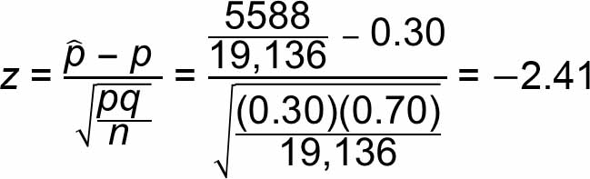
Example: Fewer Than 30% of Adults have Sleepwalked? (6 of 8)
Solution
Table A-2 If technology is not available, proceed as follows to conduct the hypothesis test using the P-value method.
The test statistic z = −2.41 is calculated as follows:

Slide 37
Example: Fewer Than 30% of Adults have Sleepwalked? (7 of 8)
Solution
For this left-tailed test, the P-value is the area to the left of the test statistic. Using Table A-2, we see that the area to the left of z = −2.41 is 0.0080, so the P-value is 0.0080.
Step 7: Because the P-value of 0.0080 is less than or equal to the significance level of 0.05, we reject the null hypothesis.

Slide 38
Example: Fewer Than 30% of Adults have Sleepwalked? (8 of 8)
Interpretation
Because we reject the null hypothesis, we support the alternative hypothesis. We therefore conclude that there is sufficient evidence to support the claim that fewer than 30% of adults have sleepwalked.

